Slide 1
Fastag Fraud Detection System
By Muhammad Talha Ali

Slide 2
Introduction
Problem Statement
Database Description
Data Exploration
Feature Engineering
Model Development
Real Time Fraud Detection
Explanatory Analysis
Conclusion

Slide 3

Problem Statement
Describe the challenges associated with fraud in Fastag transactions.
List the objectives and expected outcomes of the project.

Slide 4
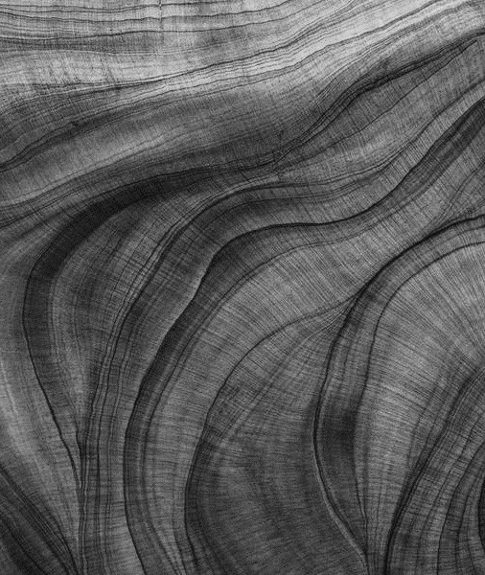
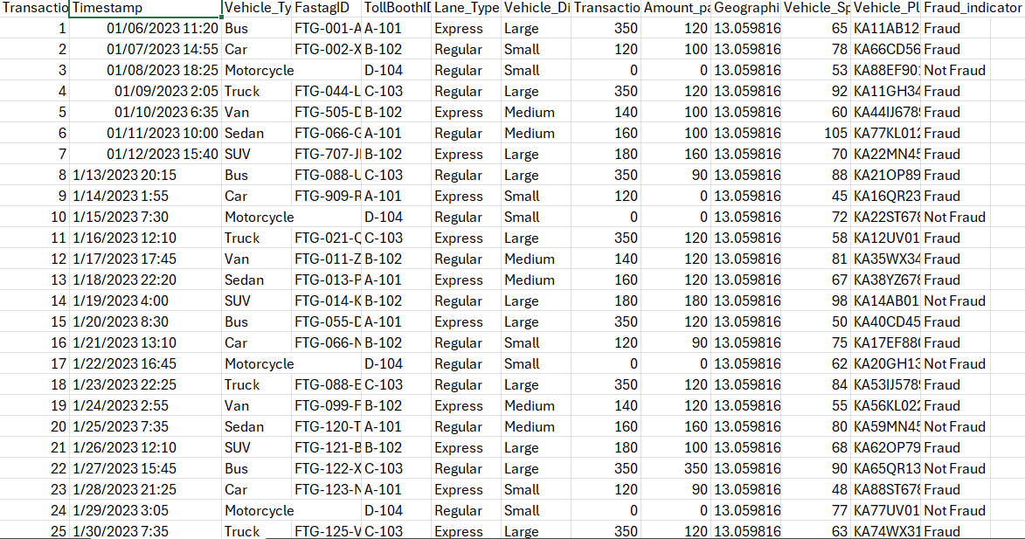
Dataset Description
Present key features of the dataset (as mentioned in the problem statement).
Highlight the importance of each feature for fraud detection.

Slide 5
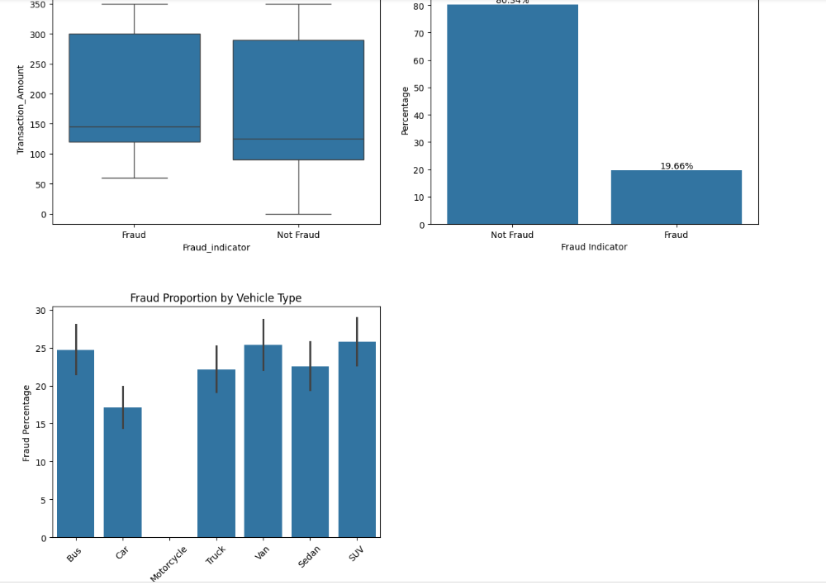
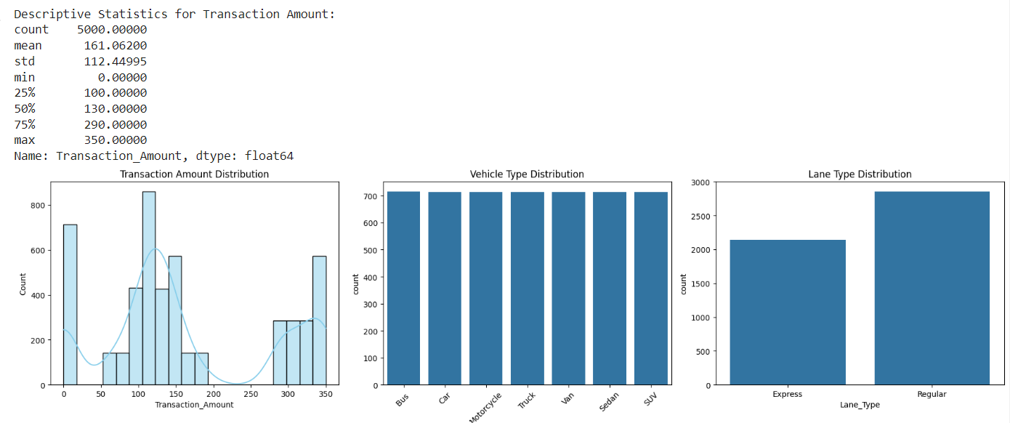
Data Exploration
Showcase visualizations of transaction amount distribution, vehicle type distribution, lane type distribution, and geographical location distribution.
Highlight any insights gained from the exploratory analysis.

Slide 6
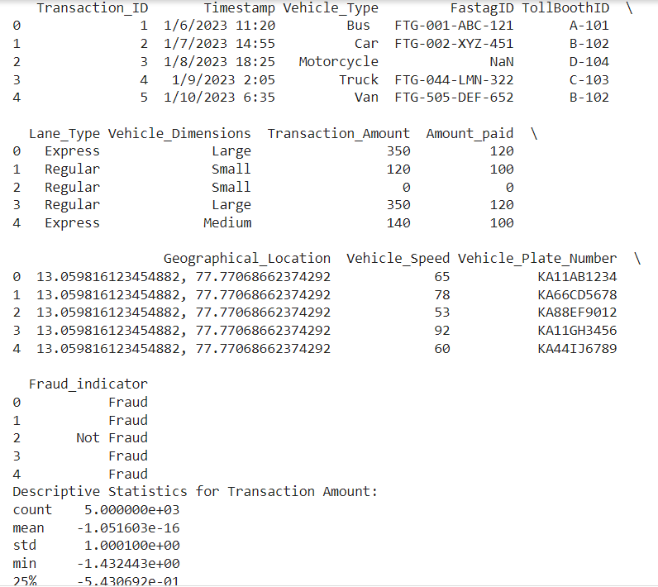
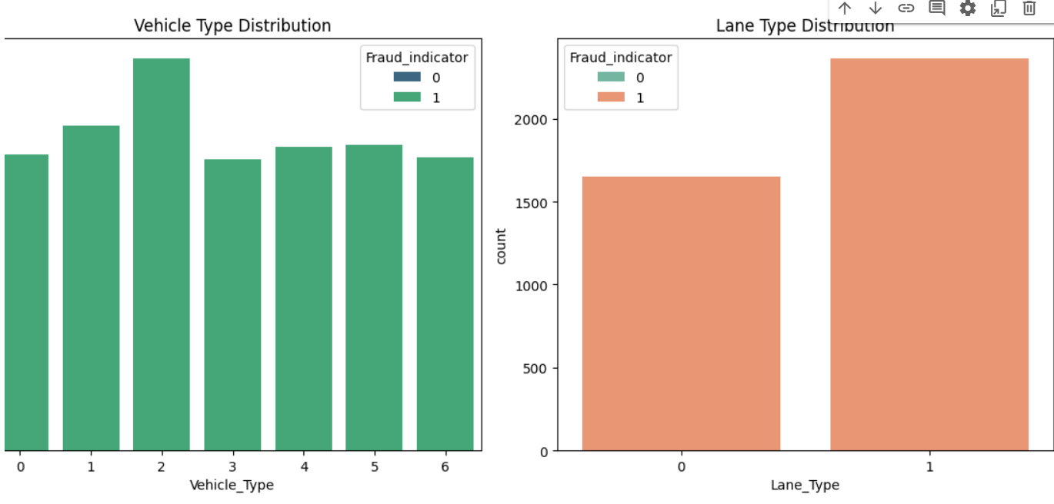
Feature Engineering
Explain the steps involved in feature engineering, including handling missing data, creating new features, encoding categorical variables, and normalizing numerical features.
Provide rationale for each step and its contribution to fraud detection.

Slide 7
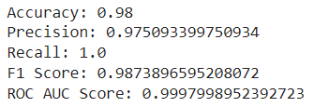
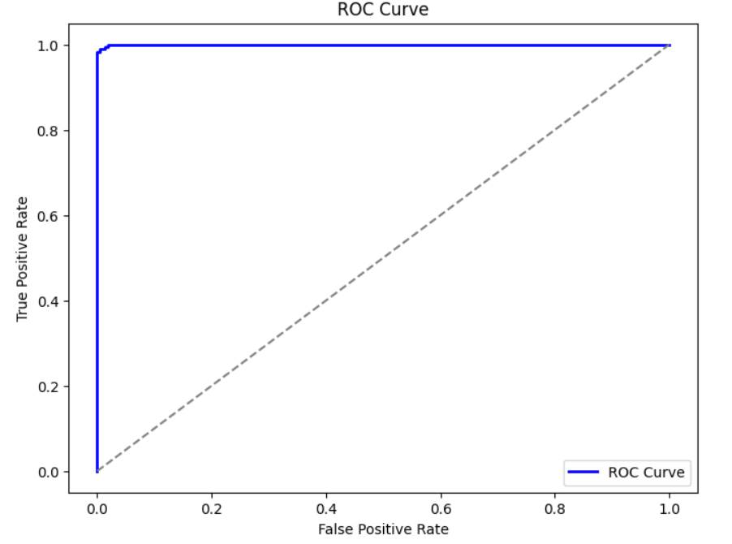
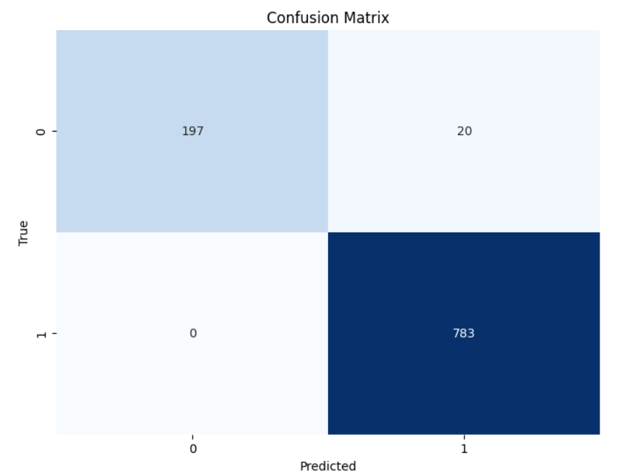
Model Development
Present the implementation of Random Forest Classifier and Logistic Regression for fraud detection.
Describe the hyperparameter tuning process using GridSearchCV.
Display evaluation metrics such as accuracy, precision, recall, F1 score, and ROC AUC score for both models.
Show visualizations of the ROC curve and confusion matrix.

Slide 8
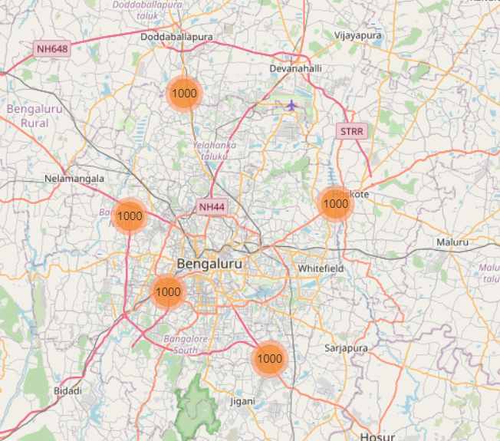
Real-time Fraud Detection
Discuss the potential for implementing the trained model for real-time fraud detection.
Mention any considerations or challenges for deployment.

Slide 9

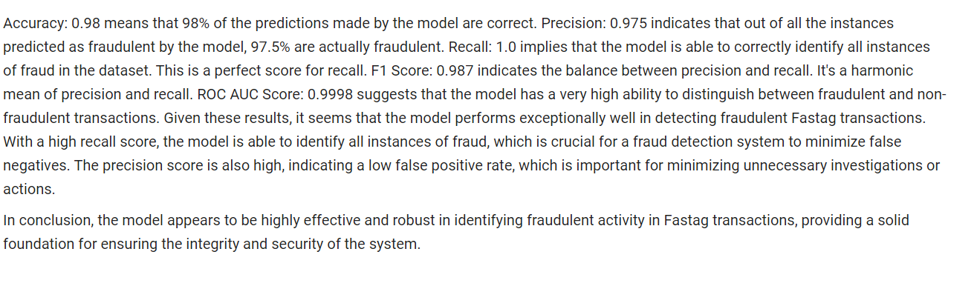
Explanatory Analysis
Provide insights into factors contributing to fraudulent transactions.
Highlight key findings from the analysis and model evaluation.

Slide 10

Conclusion
Summarize the project achievements and outcomes.
Discuss the effectiveness of the fraud detection system and its implications for Fastag transactions.
Invite questions from the audience and provide contact information for further inquiries

Slide 11
Thank you
Muhammad Talha Ali
mmtali786@gmail.com

